Slide 1
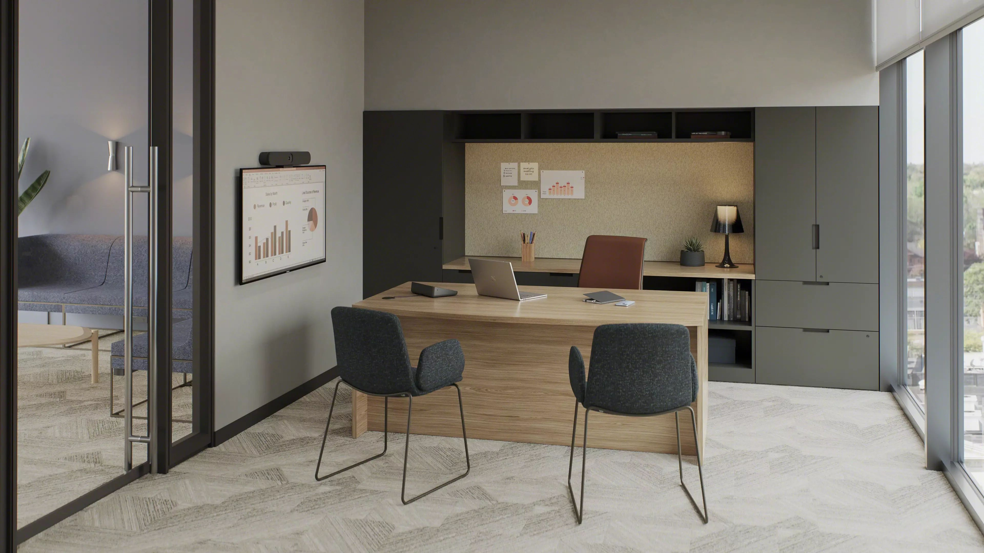


Currency
Desking + Storage

Slide 2
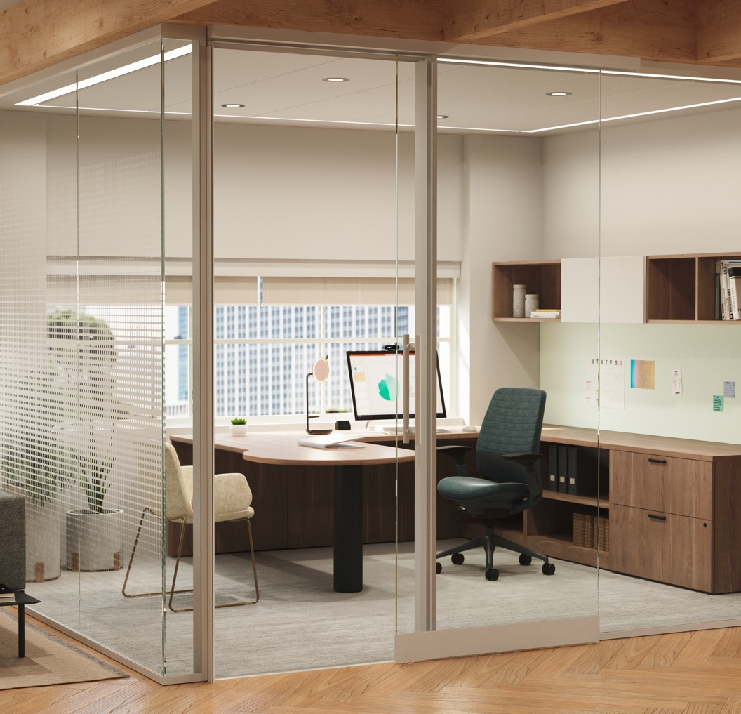
Currency goes a long way.
For the people who make work happen every day. For the organizations that count on exceptional value.
Extensive
Seamless
Versatile
Currency intentionally equips a range of areas + spaces with a full complement of casegoods
and storage components.
Currency blends seamlessly with other applications, making it a smart, singular solution for designing spaces that work for people.
Currency's customizable style options empower designers to create spaces that fit their vision.
Notes:
Alt:
In the spirit of continuous improvement, Steelcase has brought the next evolution of Currency to market.
Features:
Durable and cost-effective, Currency is a broad portfolio of laminate desking, storage and conferencing solutions that work hard and look great in settings of all types – from private offices to the open plan and everywhere in between.
Benefits:
Extensive (Cohesive, customizable and cost-effective)
Currency intentionally equips a range of areas + spaces (private offices, dynamic open work areas) with a full complement of casegoods and storage components for an extensive, rich and cohesive experience that doesn’t break the budget. And, with parametric capabilities, you can fit for the exact needs of your space or application – down to the 1/16 of an inch putting customization in the hands of the designer.
Seamless (Works alone + blends well)
Currency's extensive line, blending seamlessly with other applications, makes it a smart single solution for designing spaces that work for people.
Its carefully planned dimensions and rich variety of style choices means that Currency also blends with other applications and product lines like second nature. Currency desking and storage solutions integrate easily into holistic modular panel systems. They make smart additions – and starting points – for designing spaces that go far for the people who use them.
Versatile (Attractive choices in more ways than one)
Currency's customizable style options empower designers to create spaces that fit their vision. Whether nodding to tradition or setting new trends, designers can strike exactly the right tone by leveraging the wide palette of woodgrain and solid laminates.

Slide 3
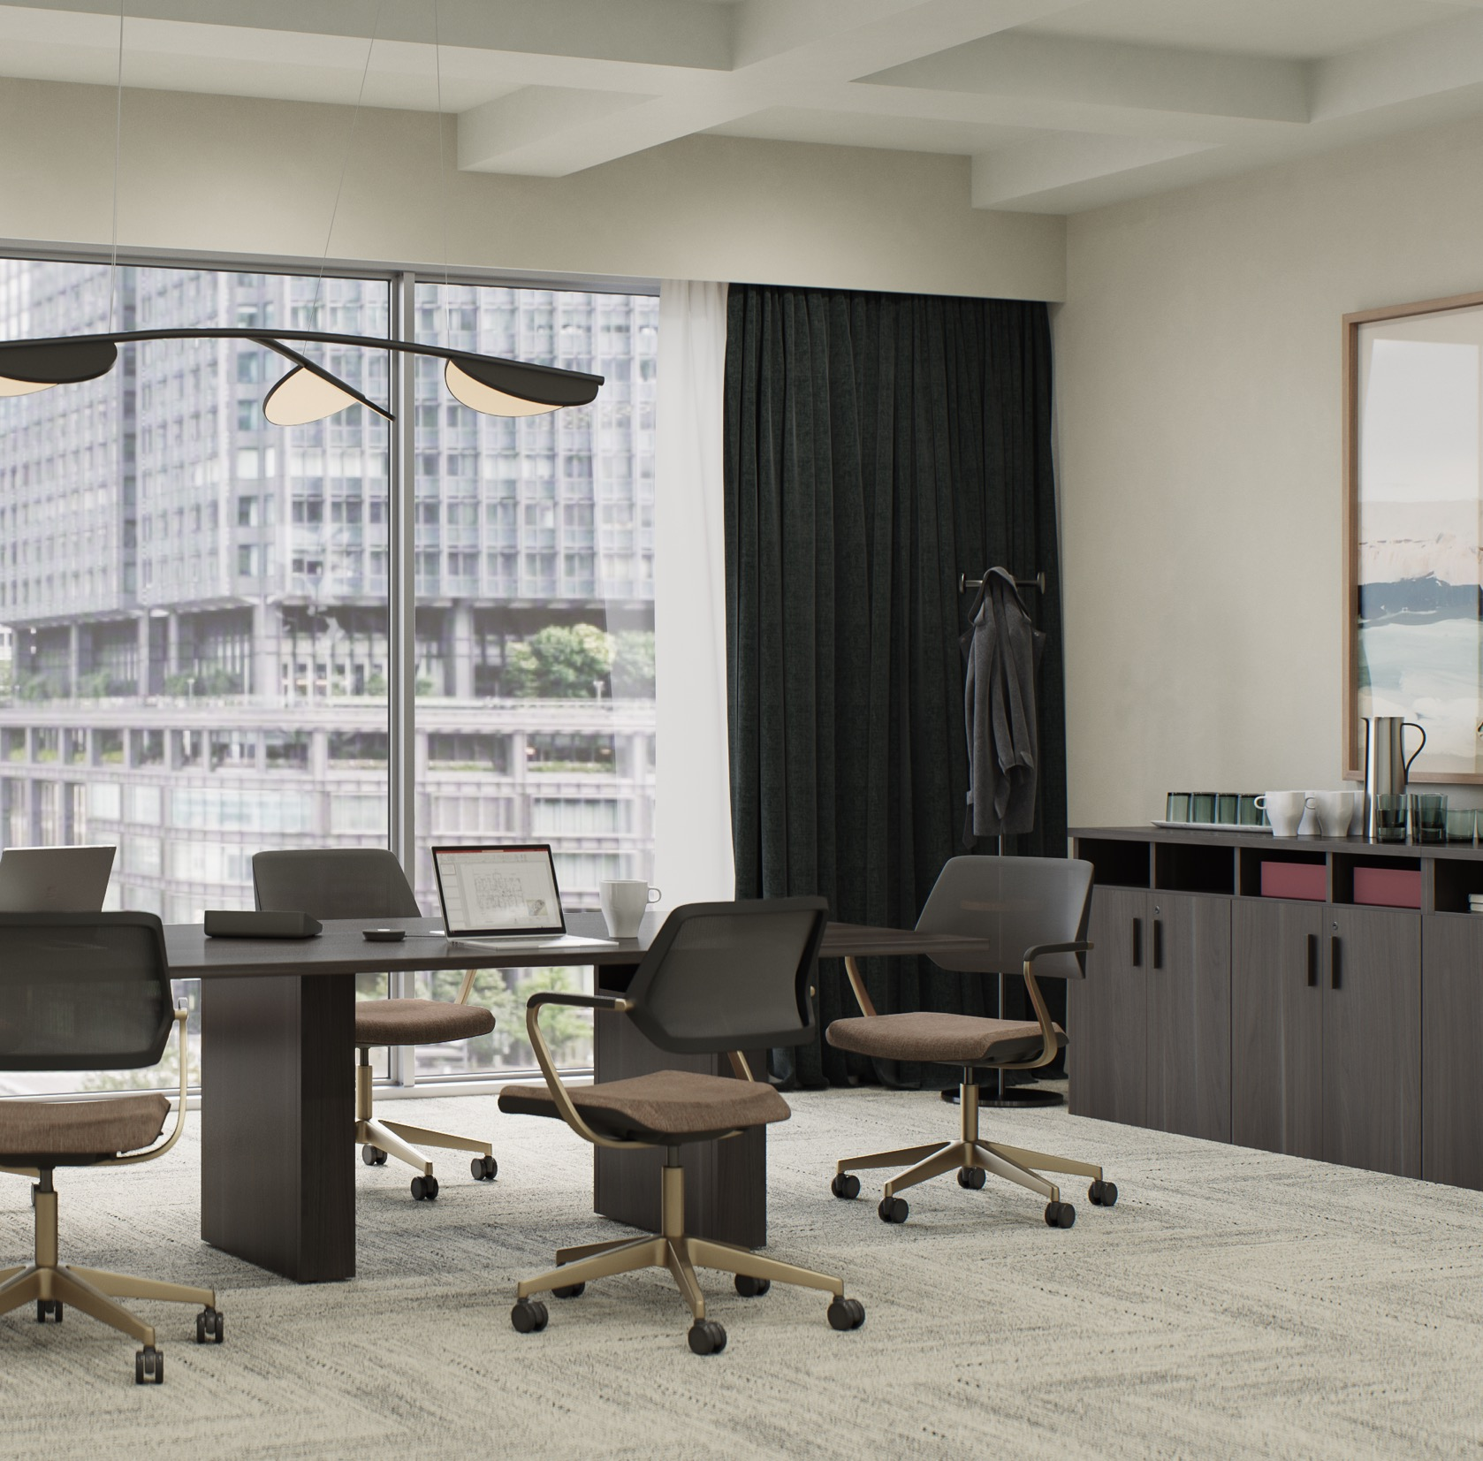
Cohesive, customizable and cost-effective
Currency intentionally equips a range of areas + spaces with a full complement of casegoods
and storage components.
Notes:
Extensive
Currency intentionally equips a range of areas + spaces (private offices, dynamic open work areas, and inviting ancillary spaces) with a full complement of casegoods and storage components for an extensive, rich and cohesive experience that doesn’t break the budget. And, with parametric capabilities, you can fit for the exact needs of your space or application – down to the 1/16th of an inch putting customization in the hands of the designer.

Slide 4
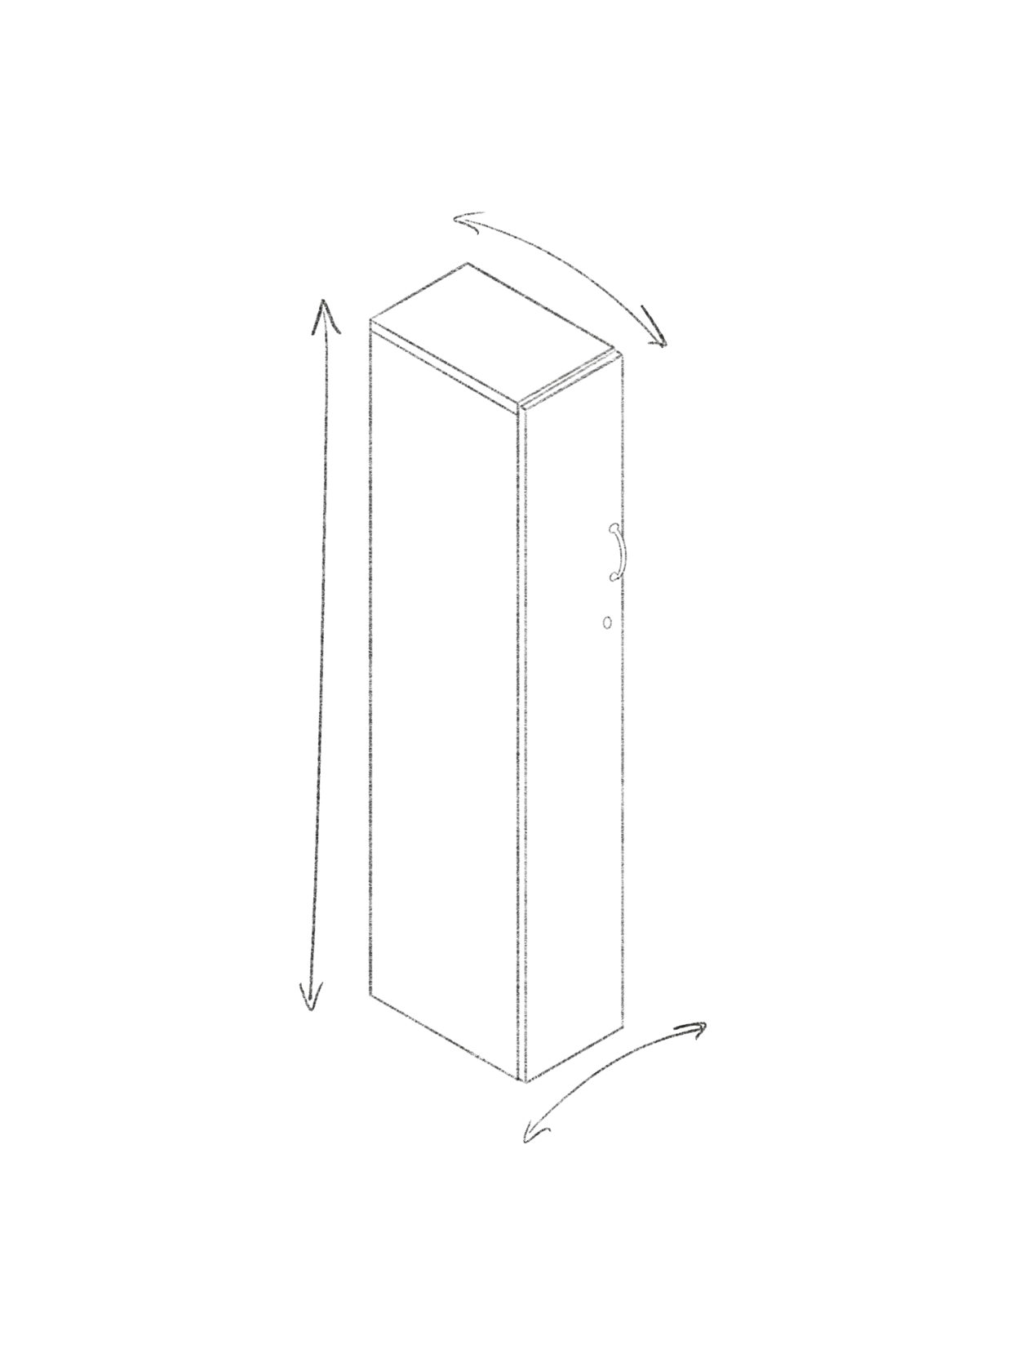
One size does not fit all when every inch of a space matters.
Parametric Capabilities
Parametric Depth
Parametric Height
Customize settings and applications with a truly tailored fit.
Precision down to 1/16 of an inch.
Parametric Width
Notes:
Parametric Capabilities
One size does not fit all when every inch of a space matters.
Fit for the exact needs of your space with parametric capabilities – down to the 1/16 of an inch.
With this level of precision, you can customize settings with a truly tailored fit.

Slide 5
Works alone + blends well
Currency blends seamlessly with other applications, making it a smart, singular solution for designing spaces that work for people.
Notes:
Seamless
Currency blends seamlessly with other applications, making it a smart, singular solution for designing spaces that work for people.
Its carefully planned dimensions and rich variety of style choices means that Currency also blends with other applications and product lines like second nature. Currency desking and storage solutions integrate easily into holistic modular panel systems. They make smart additions – and starting points – for designing spaces that go far for the people who use them.
Products Currency blends with:
Elective Elements
Slim Leg HAD
Migration SE
Ology
Answer Panel
Answer Beam

Slide 6
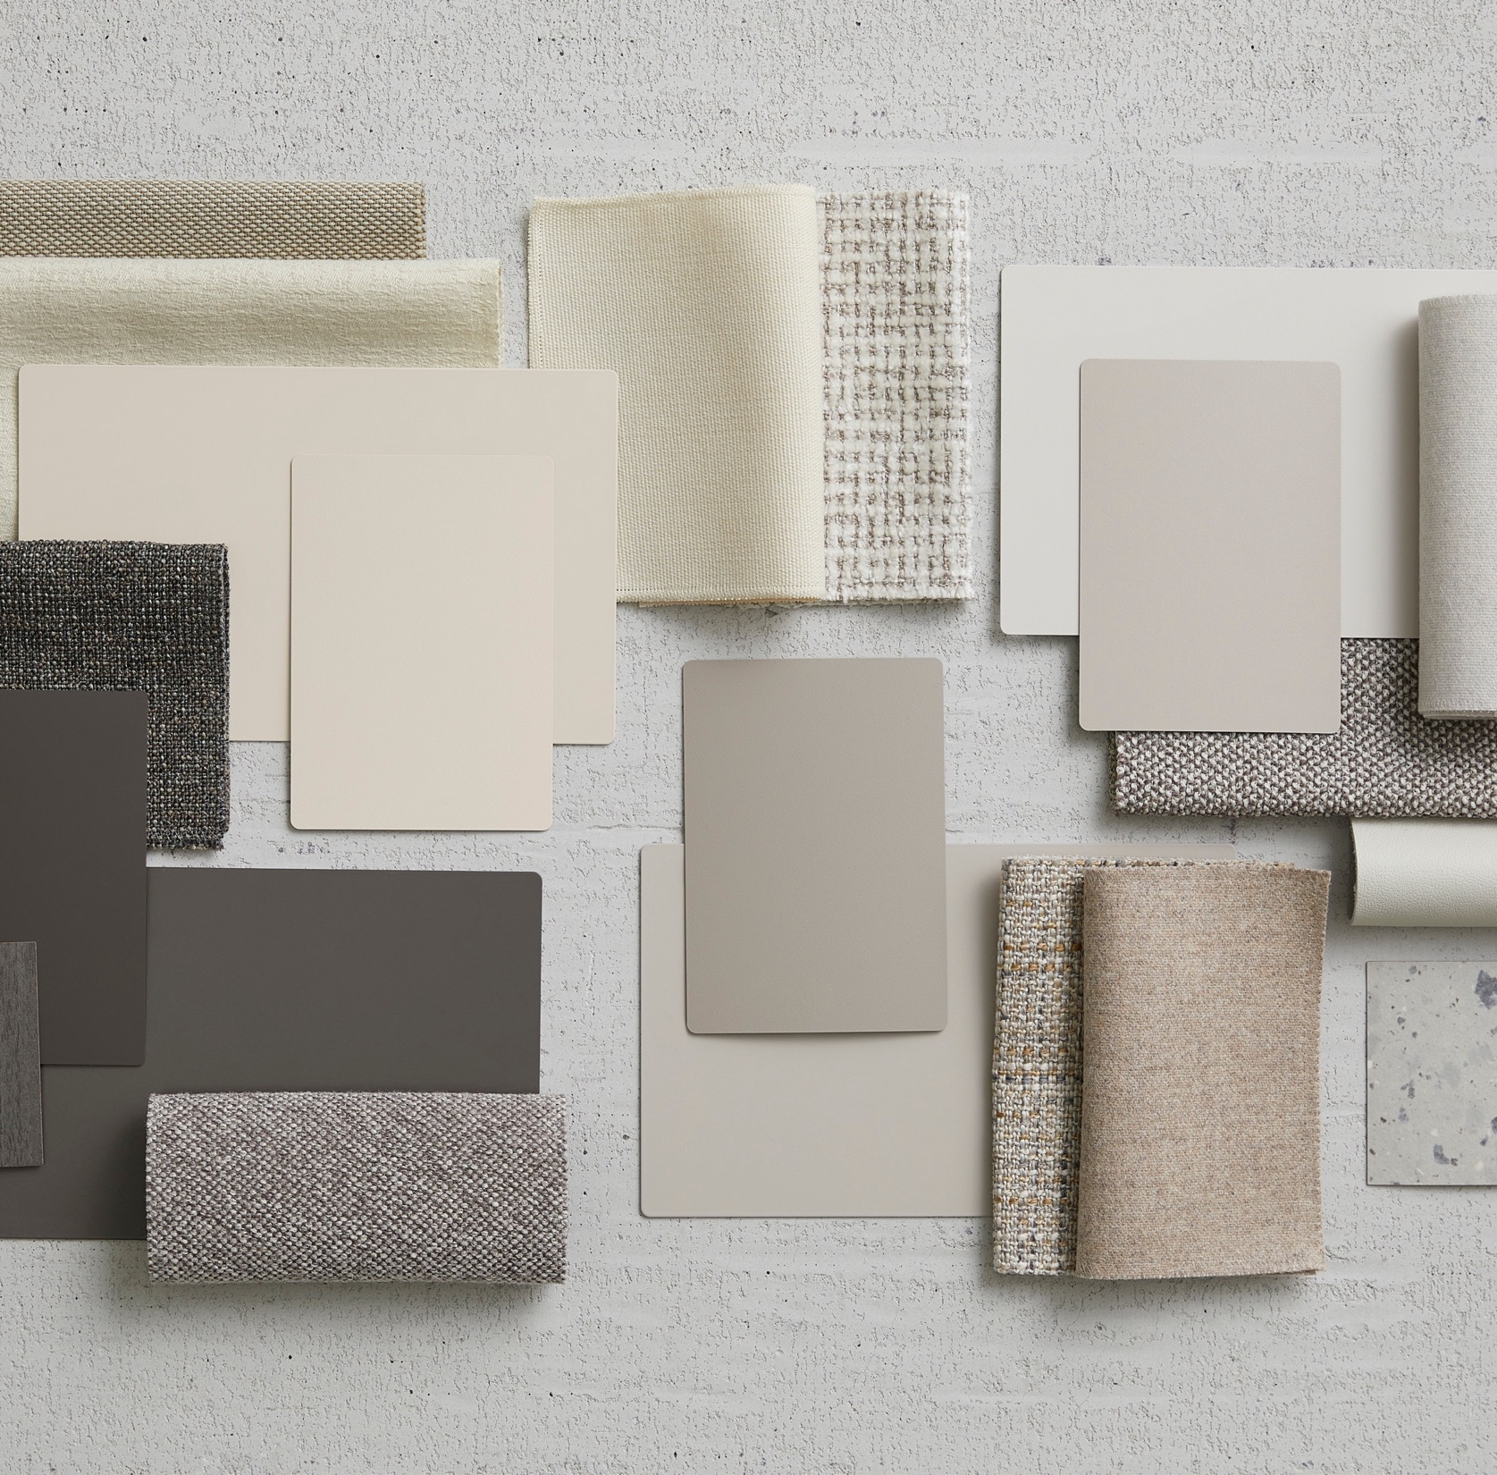
Attractive choices in more ways than one
Currency's customizable style options empower designers to create spaces that fit their vision.
Notes:
Versatile
Currency's customizable style options empower designers to create spaces that fit their vision. Whether nodding to tradition or setting new trends, designers can strike exactly the right tone by leveraging the wide palette of woodgrain and solid laminates.
Go with High-Pressure Laminate for a library of ~200 options, including textured laminate and satin laminate, or when blending with other HPL products.
Go with Low-Pressure Laminate when being cost effective is paramount.
Go with Open Line Laminate when looking to express brand personality with a specific finish not supported in the Steelcase standard finish library.

Slide 7
From Private Office to Open Plan
Notes:
Applications

Slide 8
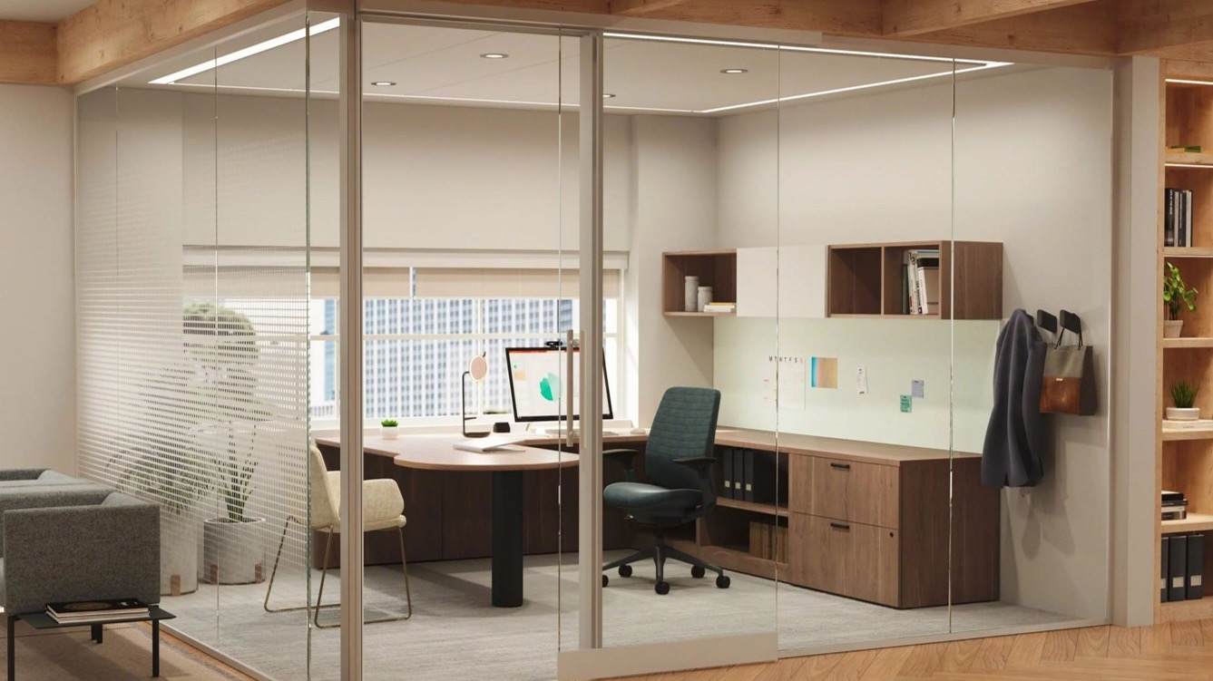
Private Office
Multiple desking options create a seamless and unified office that best fits the user.
Above-the-worksurface storage frees up space for the user without sacrificing function.
Lower storage keeps documents and belongings accessible while maximizing the floorplan.
Notes:
The private office is still a staple of the workplace. Currency’s broad statement of line and functionality enables it to fit in traditional and innovative private offices.

Slide 9
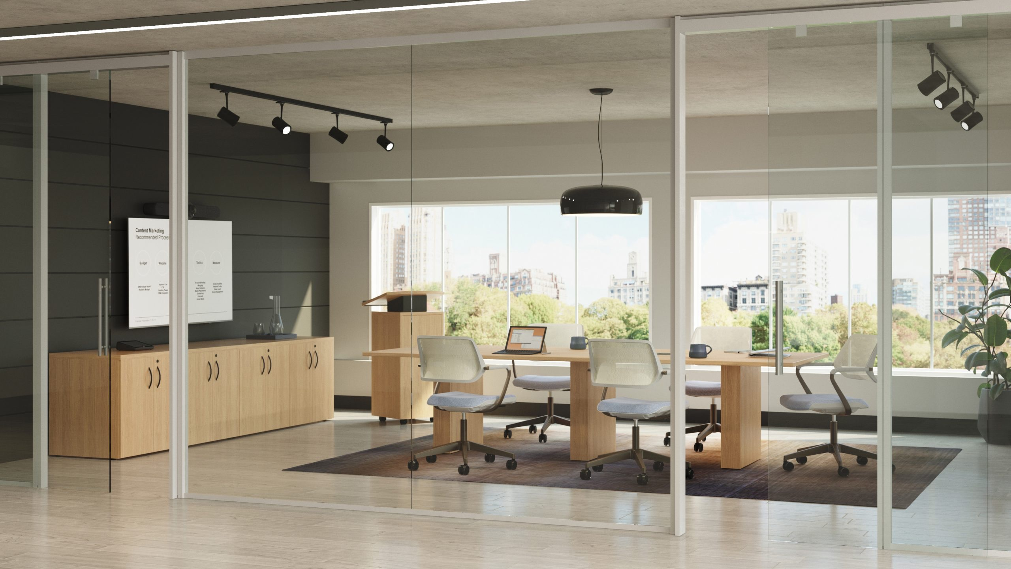
Conferencing
Currency offers a breadth of solutions spanning from small café tables to large conference tops in a variety of shapes.
Available with hinged door power unit, cleanly concealing cords within rectangular base.
Keep a consistent visual throughout the space with conference furniture staples, including lecterns, service carts, and buffet credenzas.
Multiple base options provide choice at an attractive price point.
Notes:
Plan with Currency in conference applications with a portfolio of tables, bases, and furniture, including a lectern, and service carts.

Slide 10
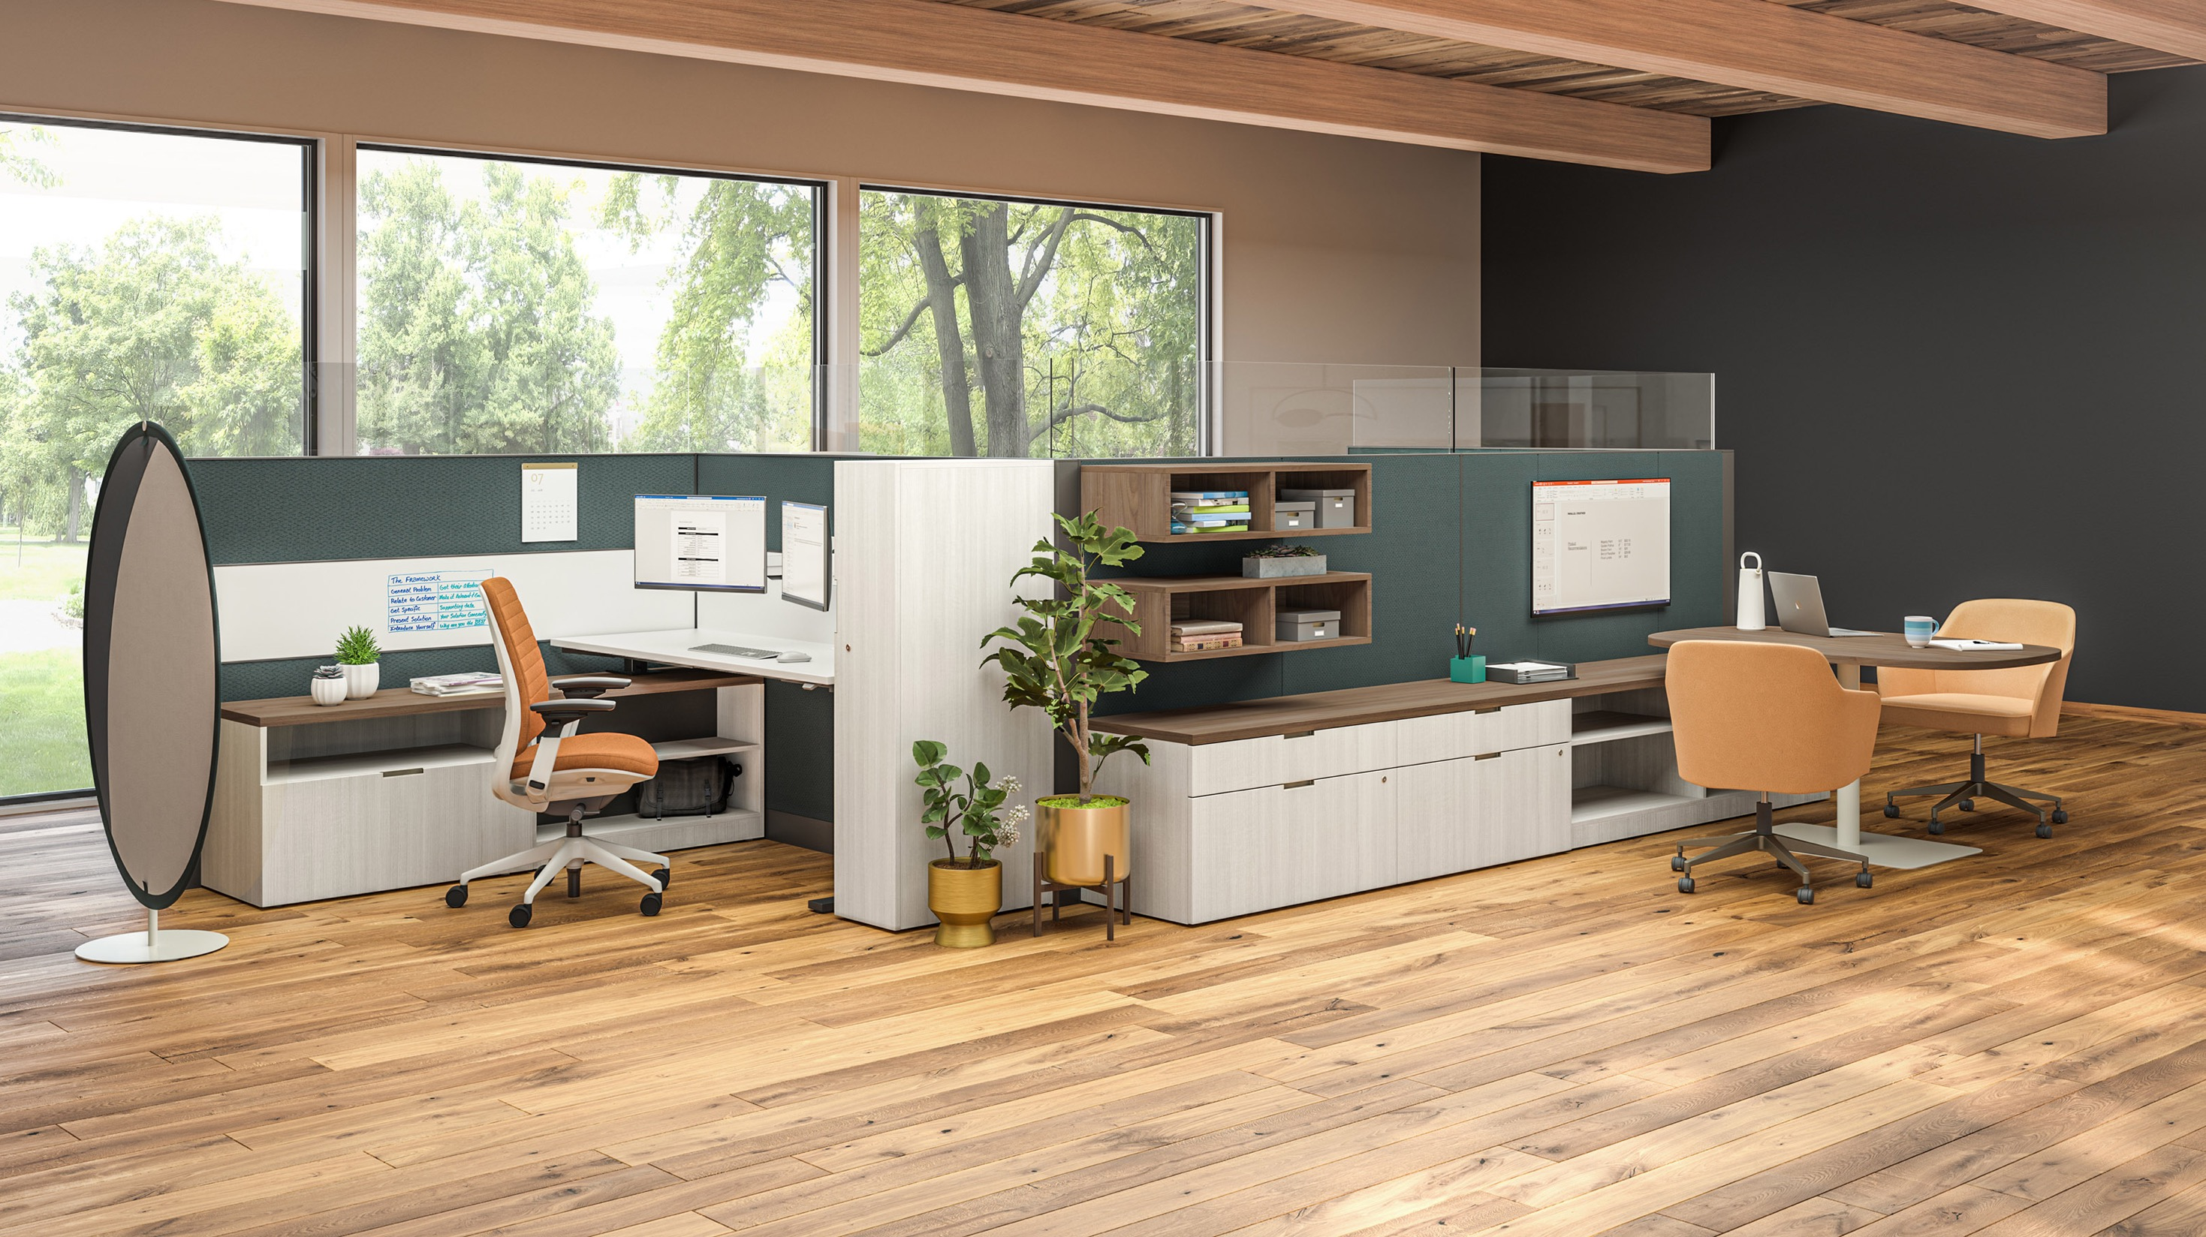
Open Plan
Thoughtful design and intentional dimensions allow Currency to augment Answer Panel and Answer Beam.
Brings laminate to the open plan, offering a warmer alternative to typical storage selection in these spaces: steel.

Slide 11
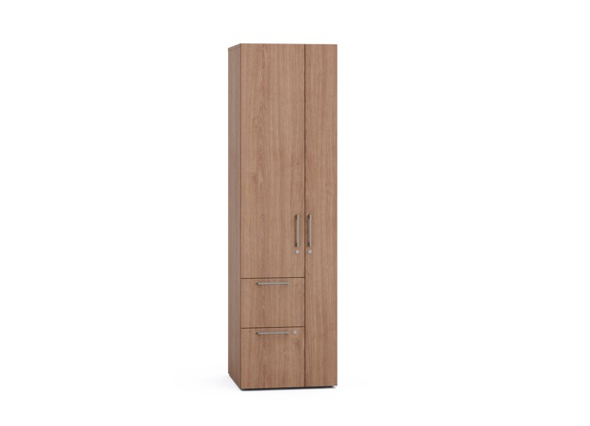
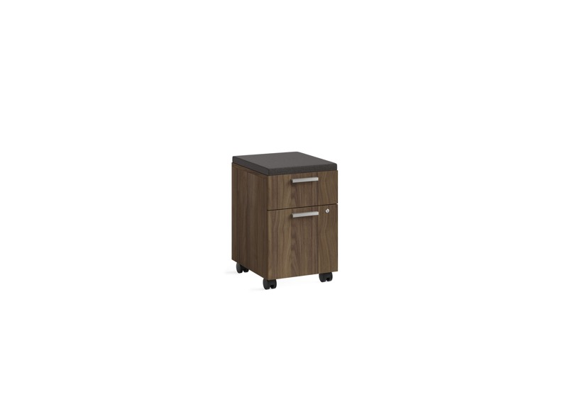
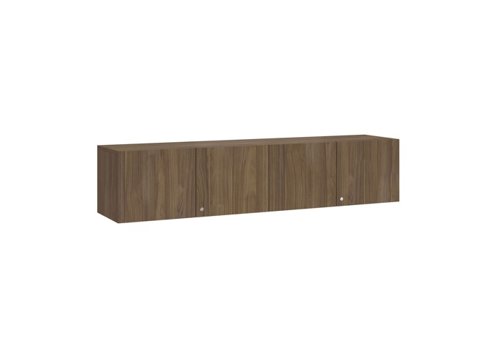
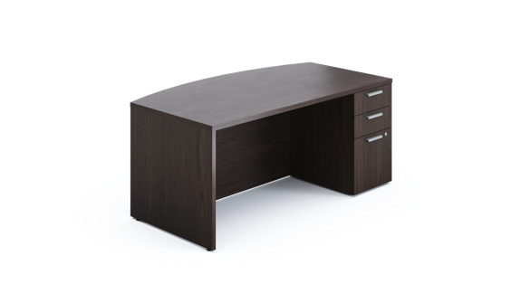
Statement of Line
Desking + Worksurfaces
Desks and desk shells (rectilinear and bow-front)
Corner desk shells (extended curved corner and curved corner
Returns and return shells
Bridges
D-shape and P-shape worksurfaces
Parametric worksurfaces
Tall Storage
Three-high and four-high lateral files
Bookcases
Towers
Wardrobes
Combination cabinets
Low Storage
Fixed and mobile pedestals
Lateral files
Open low storage
Low cabinet
Height-adjustable desk-integrated storage
Credenzas
Overhead Storage + Accessories
Overheads
Organizers
Stacking overheads
Stacking bookcases
Tackboards
Conferencing Furniture
Lecterns
Service carts
Buffet credenzas
Variety of tabletop and base combinations
Notes:
The Currency line is incredibly comprehensive, with a wide range of solutions for open floorplan, private office, and conferencing applications. Currency coordinates and integrates with other Steelcase lines like Answer, Answer Beam, Elective Elements, Ology, Migration SE, and Slim Leg HAD

Slide 12

Sustainability: Reclaimed Laminates
Reclaimed laminates include fragments of solid color paper that otherwise would have gone to waste.
30% recycled material
Notes:
Sustainability: Reclaimed Laminates
Fragments of solid color paper that would have otherwise gone to waste are chopped up and added to liquid paper pulp to create the Reclaimed Aggregate and Reclaimed Gravel finishes, available on Currency. This technique uses small-batch craft production so that each new sheet produced is unique and natural, containing 30% recycled material.

Slide 13
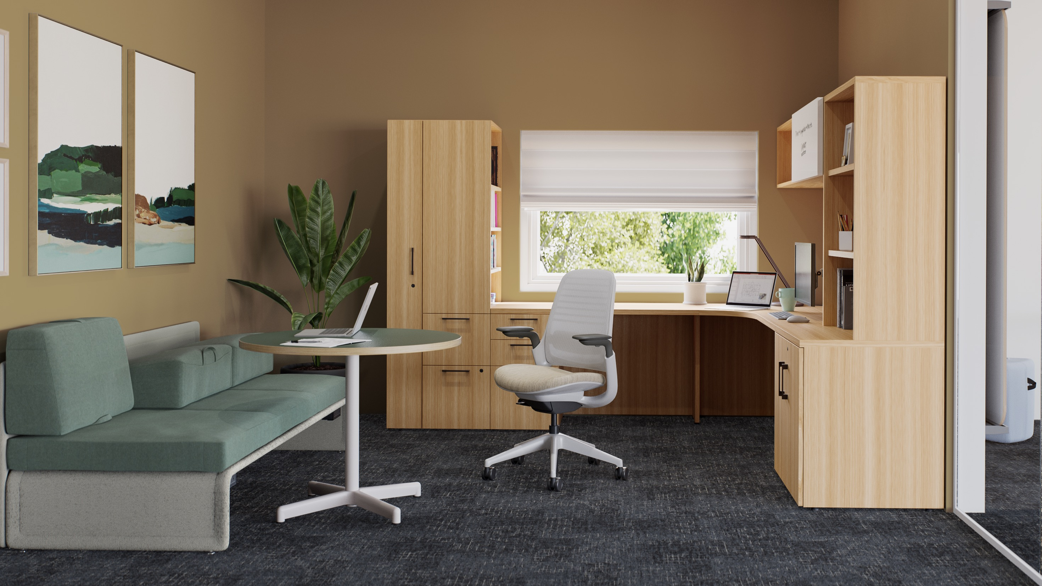

Slide 14
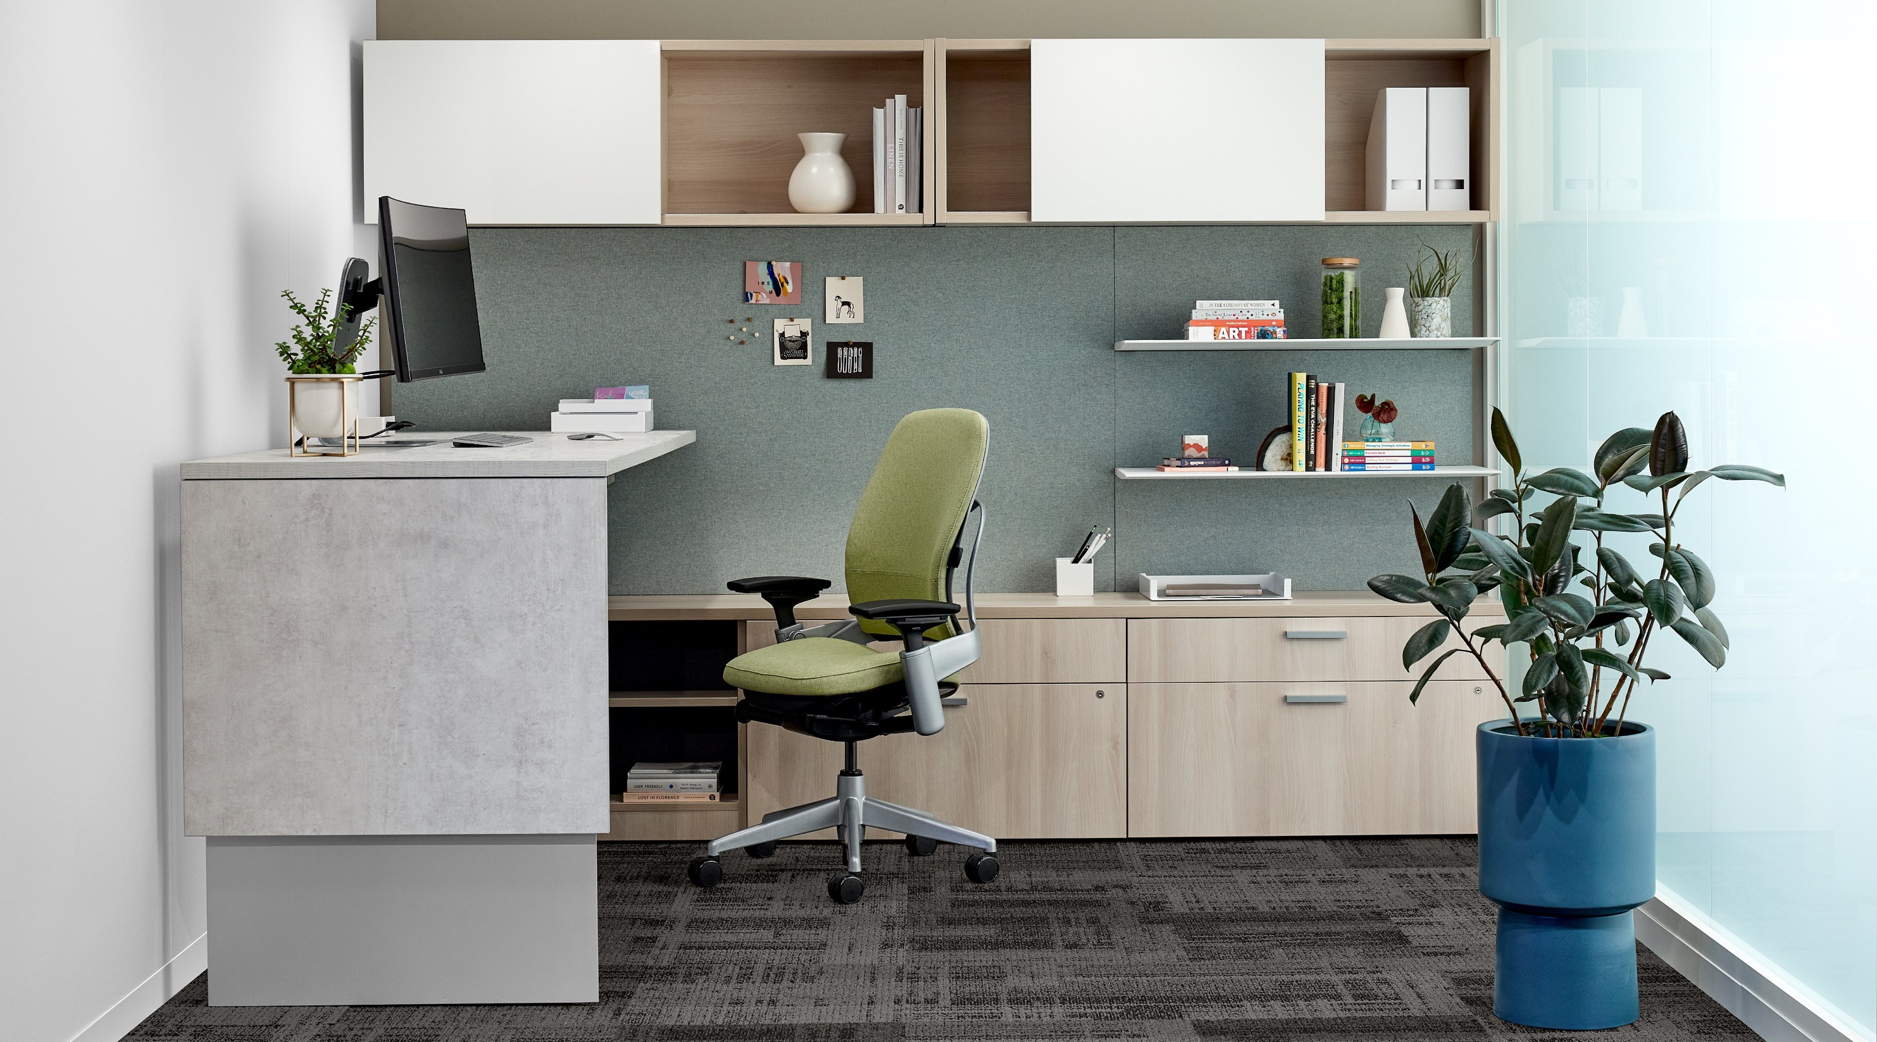

Slide 17
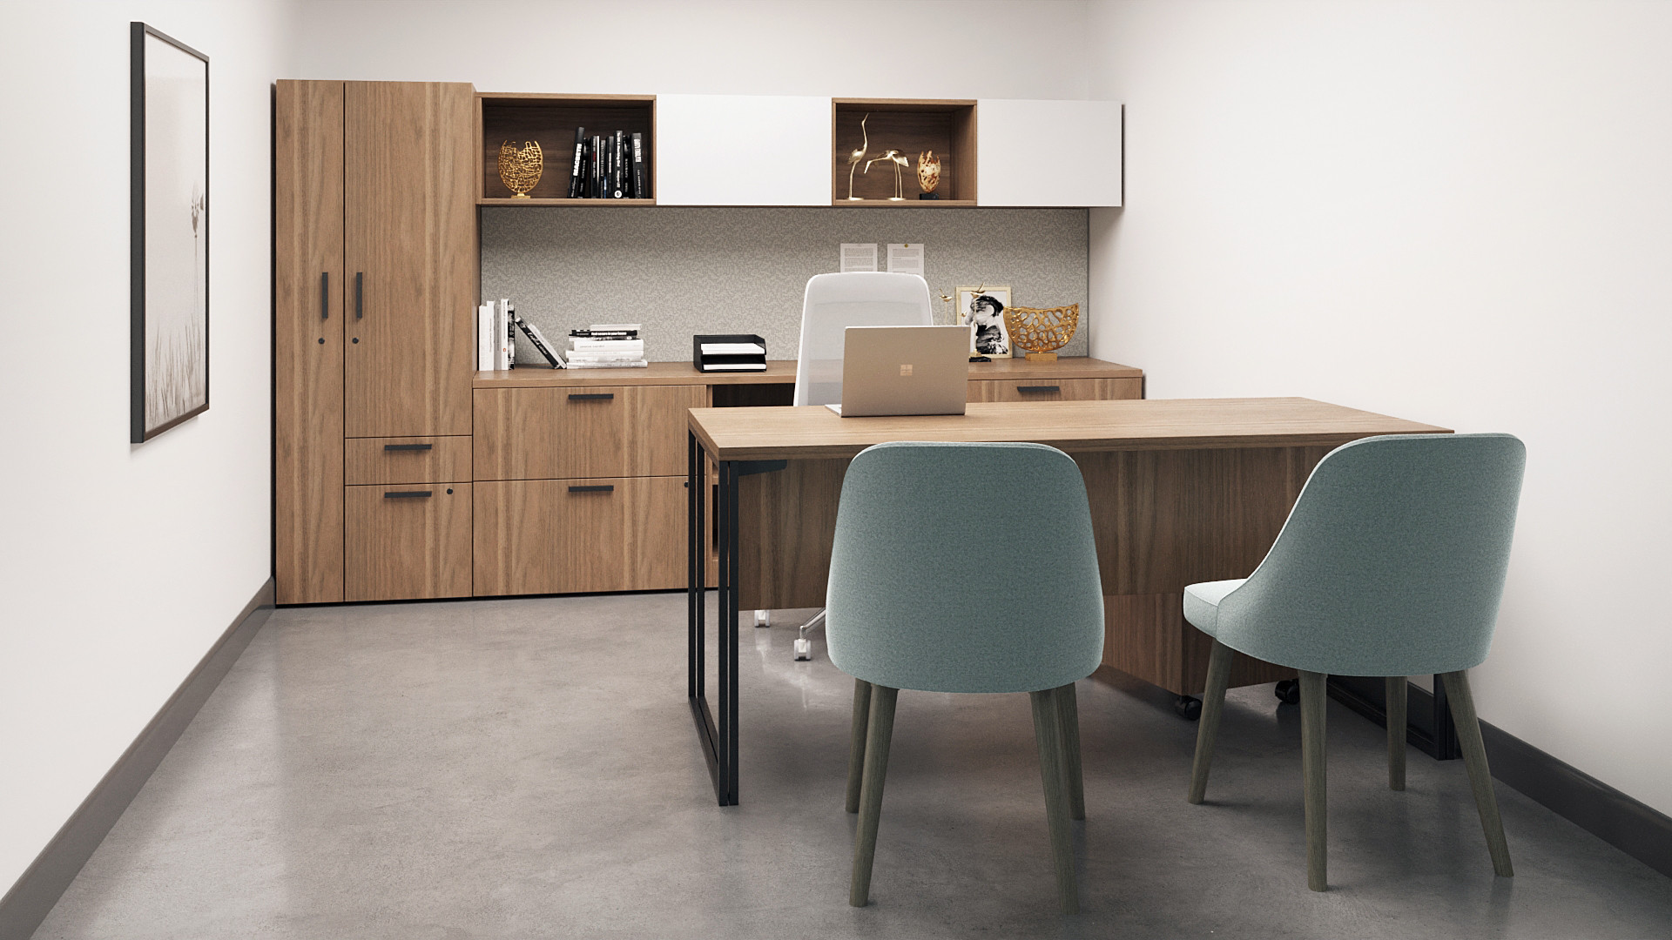

Slide 18
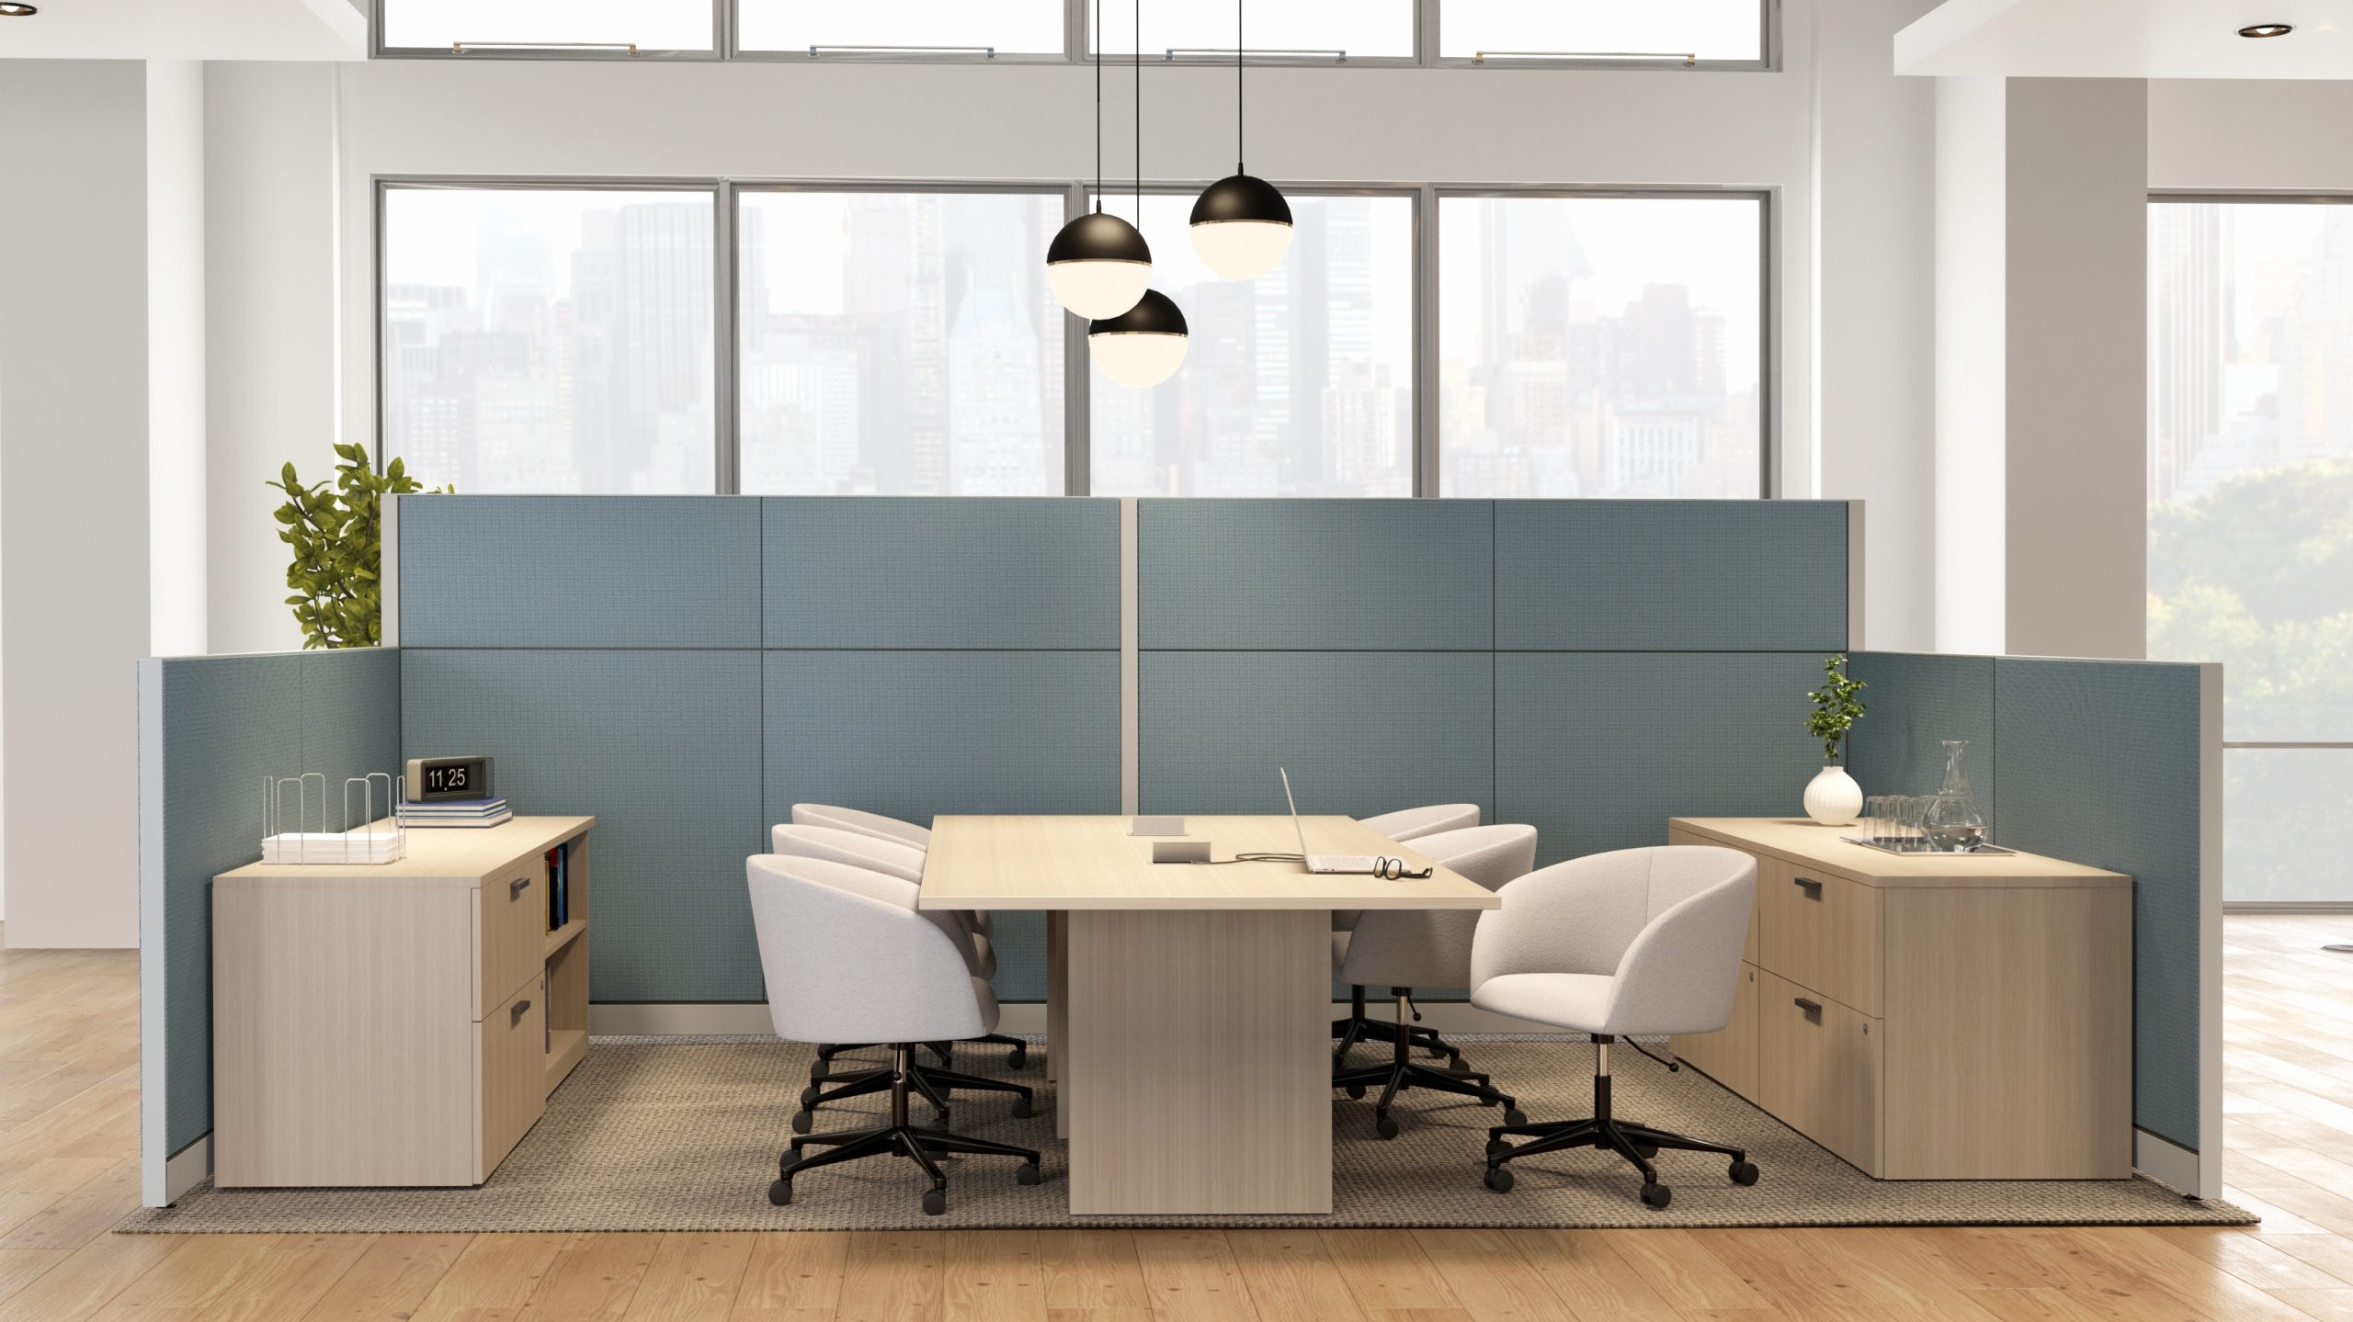

Slide 19
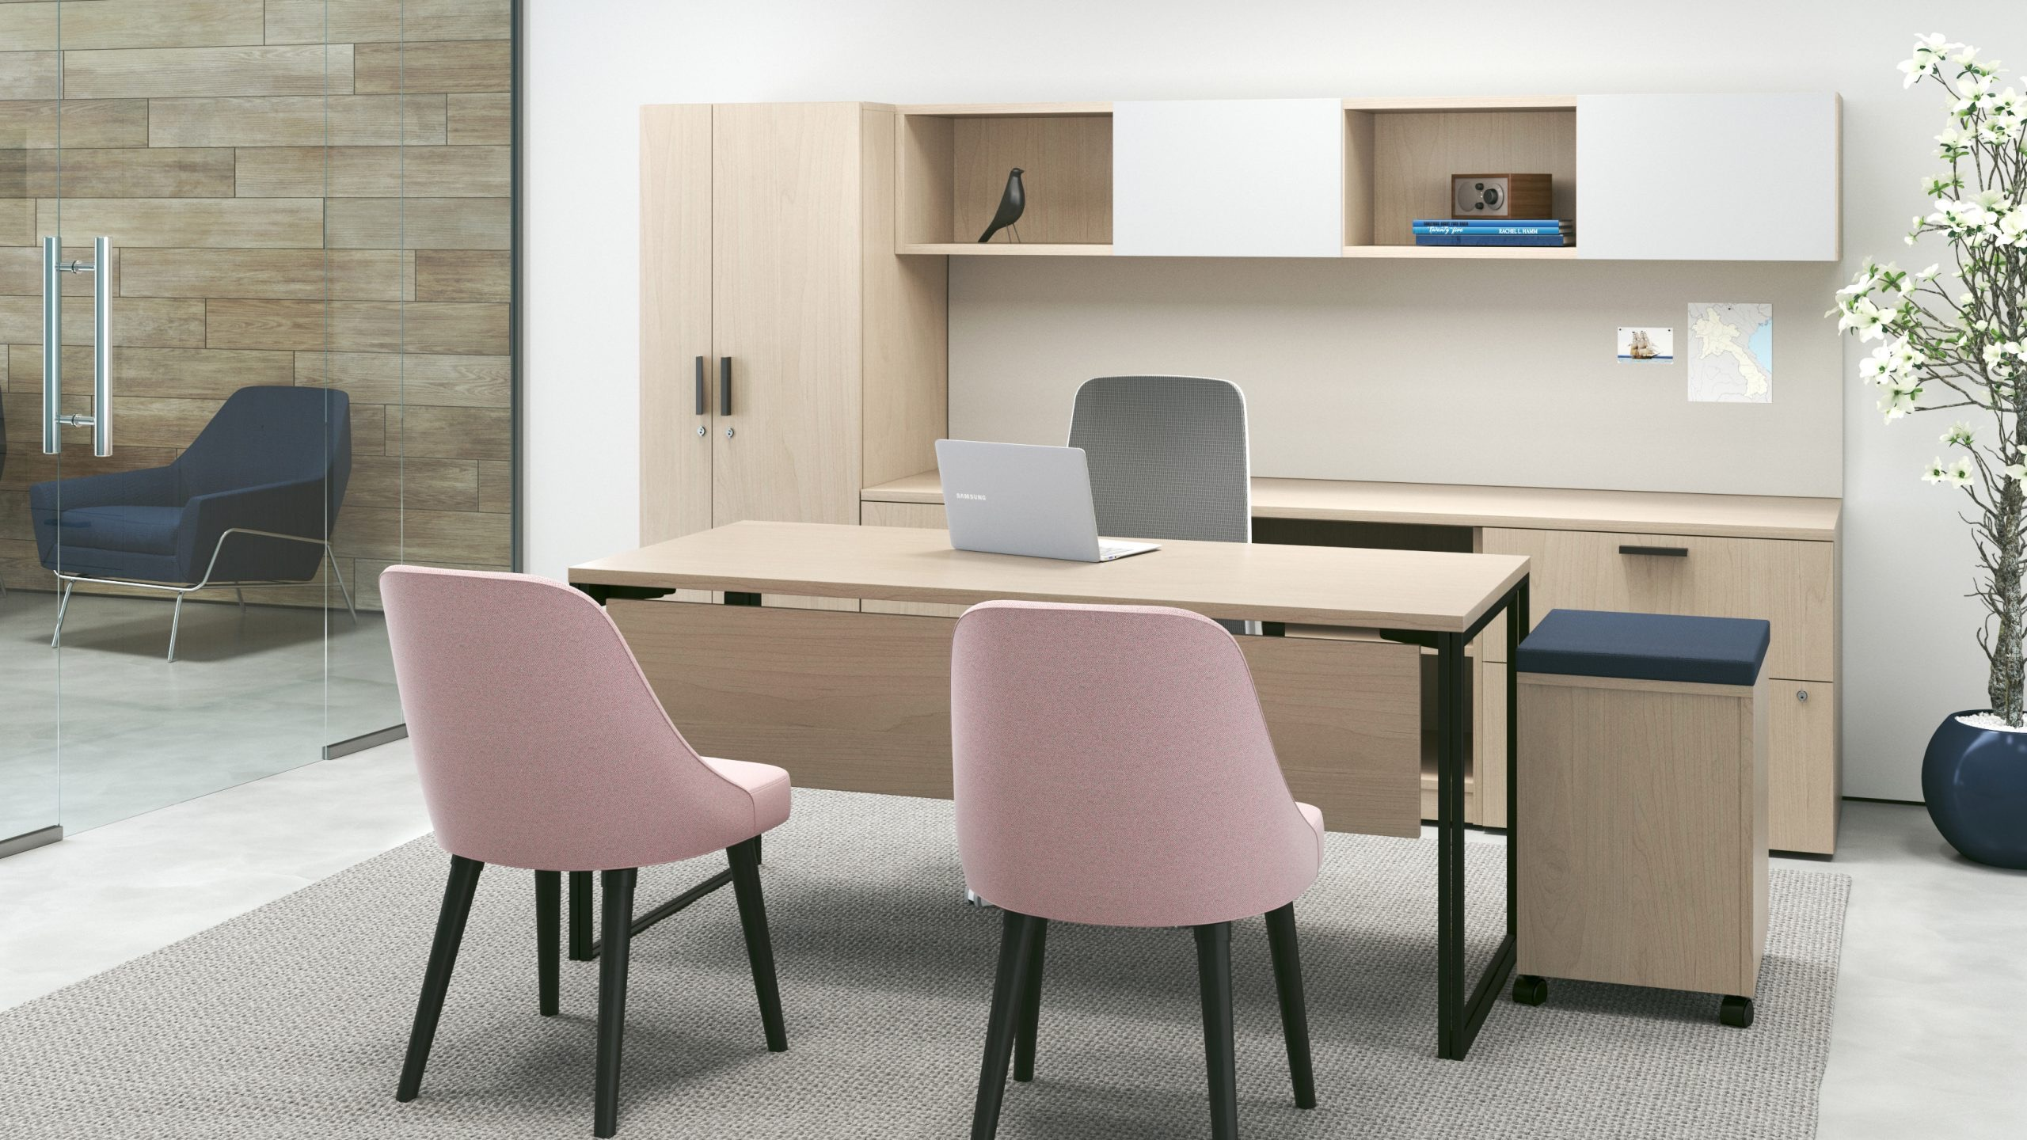

Slide 20
Better is possible.
Let us show you how.
Notes:
Better is possible. Let us show you how.

