Slide 1
Guest and Lounge Seating
Product Portfolio Overview

Slide 2
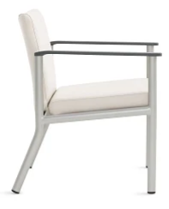
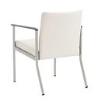
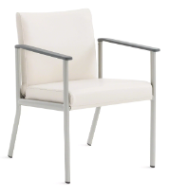
Aspekt
Features:
Suits a wide range of public seating needs
Boasts a clean, minimal design
Offers comfort through its active web-seat suspension
Arm cap overhang that’s easy to grip when entering or exiting the chair
Oval steel frames are strong, yet lightweight
Seating can be stand alone or grouped into a variety of ganged configurations
Crumb sweep for easy cleaning
Dynamic load 275 lbs.
Static load 500 lbs.
Available With:
One-, two-, and three-seat units
Multi-seat units with center arms and legs, center arms with legs on ends or arms and legs on ends only
Bariatric, two- and three-seat combination units, bench, easy access and patient high-back models
Straight or wallsaver legs
Straight or wave arms
Ganging brackets to link chairs
Matching footstool
Convex, concave, or combination back styles
Plastisol or maple wood arm caps (wave) or plastic, maple wood or solid surface arm caps (straight)
Coordinating freestanding and ganged tables
Moisture barrier

Slide 3
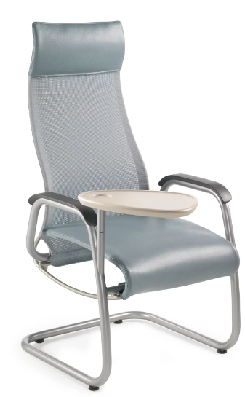
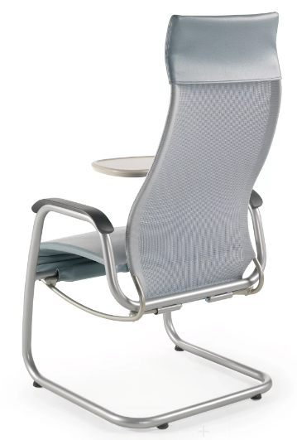
Cura
Features:
Refined ergonomics, ease of use, and renewable high-wear components
Integrated with a distinct flexing frame that accommodates even subtle movements
Promotes proper back support through a curved back frame
Independent seat and back provide additional comfort
Frame constructed with steel tubing and steel plates
Integrated promessa headrest
Dynamic load 300 lbs.
Static load 500 lbs.
Available With:
Single chair; high-back and mid-back seating styles
Two seat widths are available 21"W or 24"W.
Sled or four leg base
Urethane or wood arm caps
Tablet arm
Two auxiliary casters on back frame
Curanet mesh, promessa, or upholstered seat

Slide 4
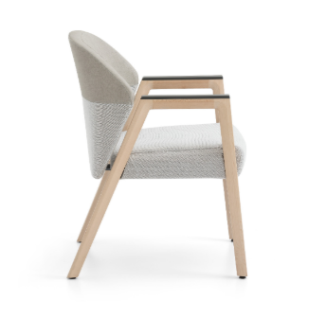
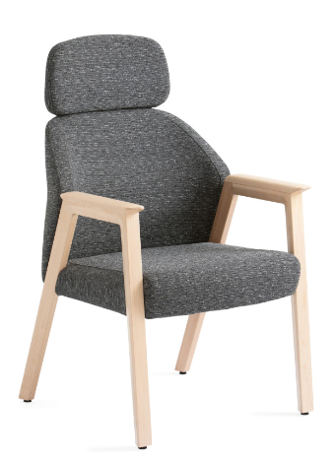
Embold
Features:
Wood and metal frame available in same design aesthetic
Supportive curved back and contoured seat cushion
Wood, plastic, and solid surface arm cap options available with overhang and no overhang
Flexing back on single seats and high back
Three back upholstery style specifications
Integrated crumb sweep around entire back
Intuitive: no adjustment mechanisms
Dynamic load 300 lbs.
Static load 750 lbs.
Available With:
Single seat in 21” and 24” widths, easy access, bariatric, loveseat, and multiple seating in 66” and 88” widths
Power is available on tables and includes one standard outlet or two USB ports
Optional midarm and midleg for loveseat and multiple seating
Optional high back
Optional wallsaver glides
Overhang and no overhang arm cap options
Side tables in circular, rectangle or racetrack
Moisture barrier

Slide 5
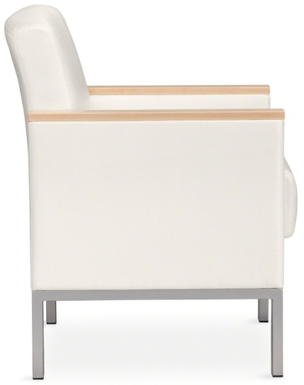
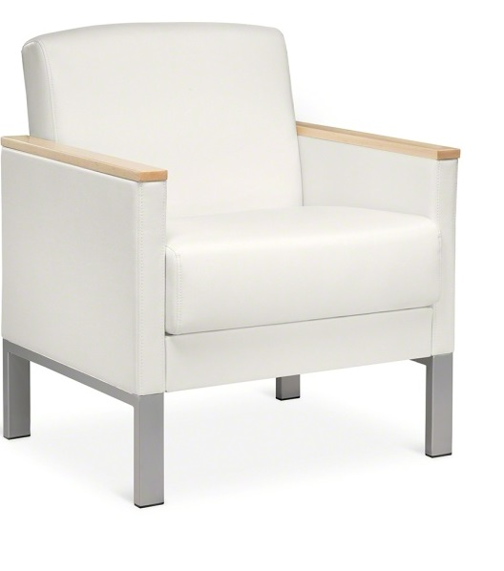
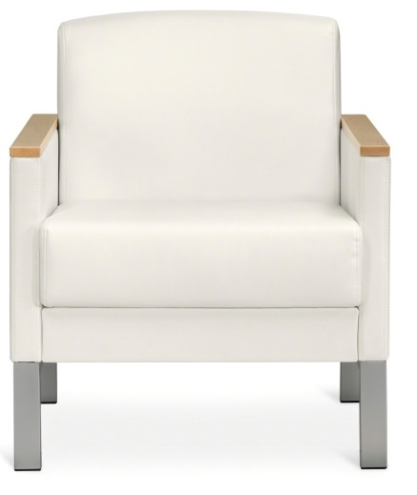
Leela
Features:
Lounge seating focused on waiting area applications
Webbed seat suspension for supportive comfort
Achieves stability and integrity with a structural steel frame
Includes a crumb sweep and bases that are easy to clean
Fully upholstered back and seat
Dynamic load 300 lbs.
Static load 750 lbs.
Available With:
Single seats in 21" and 24" widths as well as two-seat, three-seat, and bariatric lounges
Upholstered arms, wood, or plastisol arm cap options
Complimenting square and rectangular freestanding tables with steel or solid surface tops
Moisture barrier

Slide 6
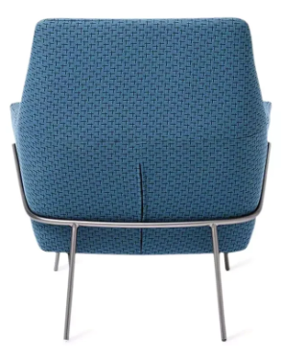
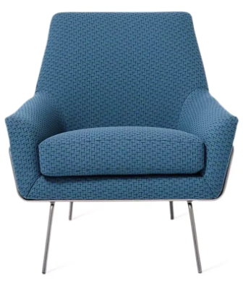
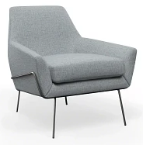
Lucas
Features:
West Elm Lucas iconic look
Wide seat make it a comfortable seat for a long period of time
Healthcare appropriate fabrics
Dynamic load 275 lbs.
Static load 275 lbs.
Available With:
Wire base or 4-star metal base

Slide 7
Mesa
Features:
West Elm Mesa’s relaxed and refined look to add style and comfort to healthcare environments
Modified for healthcare spaces with a crumbsweep and decreased recline of 112 degrees
BIFMA weight requirements
Healthcare appropriate fabrics aid in durability and cleanability
Dynamic load 600 lbs.
Static load 1200 lbs.
Available With:
Available as a left-hand chaise, right-hand chaise, armless unit, corner unit, and an ottoman

Slide 8
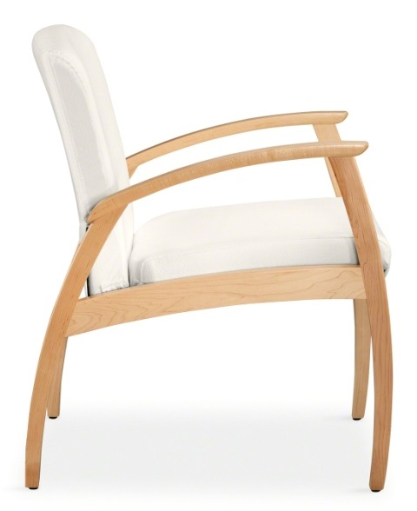
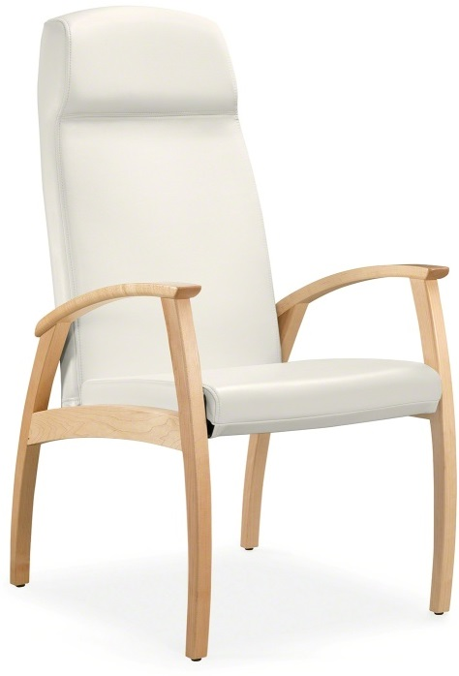
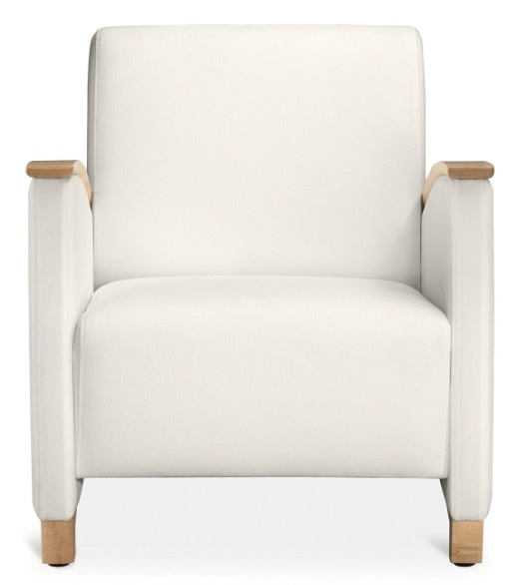
Mitra
Features:
Slim, energetic curves and structural steel inner frames
Arms and arm caps feature a reverse bevel and overhang to provide comfortable grip for ease of entry and exit
Offers added comfort through active webbed seating suspension
Generous clean out space between the seat and back for easy cleaning
Solid maple legs and frame
Dynamic load 275 lbs.
Static load 500 lbs.
Available With:
Single chair, two- and three-seat units, two- and three- seat bariatric combination units, bariatric, high-back patient chair, and single, loveseat, and sofa lounge chairs
Maple wood, plastic (guest) or plastisol (lounge) arm caps
Coordinating recliner and sleeper designs
Oval, rectangular, round and square freestanding tables with legs or drum bases
Moisture barrier

Slide 9
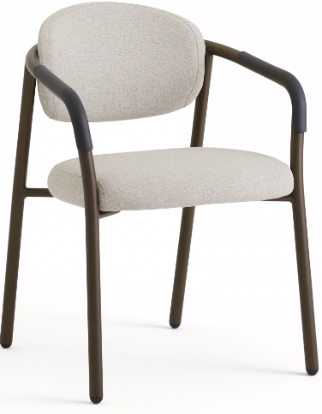
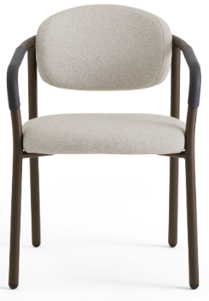
Radia
Features:
Powder coated metal framed, limited seams, and plastic arm options are highly cleanable and aid in infection control
Back cushion is contoured to provide comfort in multiple seating positions
Designed for healthcare with a crumbsweep, wallsaver legs, intentional overhang arm caps, and highly cleanable materials
Wallsaver legs
Dynamic load 400 lbs.
Static load 1000 lbs.
Available With:
Available as a single unit, bariatric unit, love seat,
Monolithic or contrasting healthcare appropriate fabrics
Moisture barrier option

Slide 10
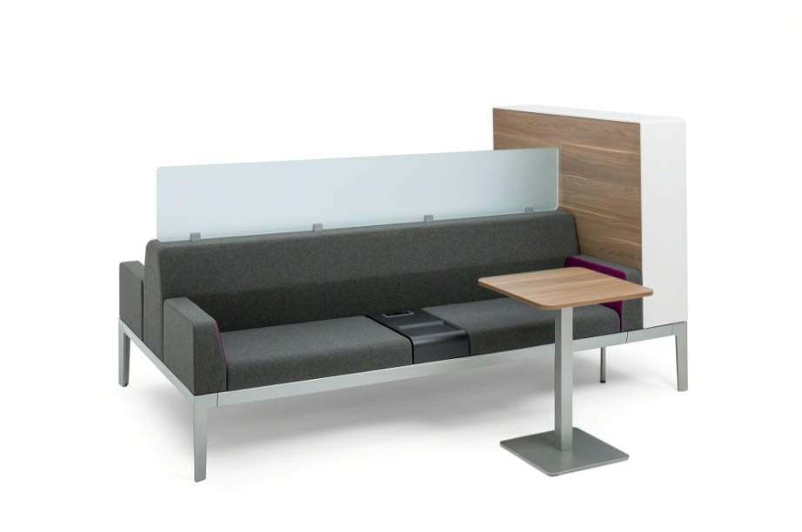
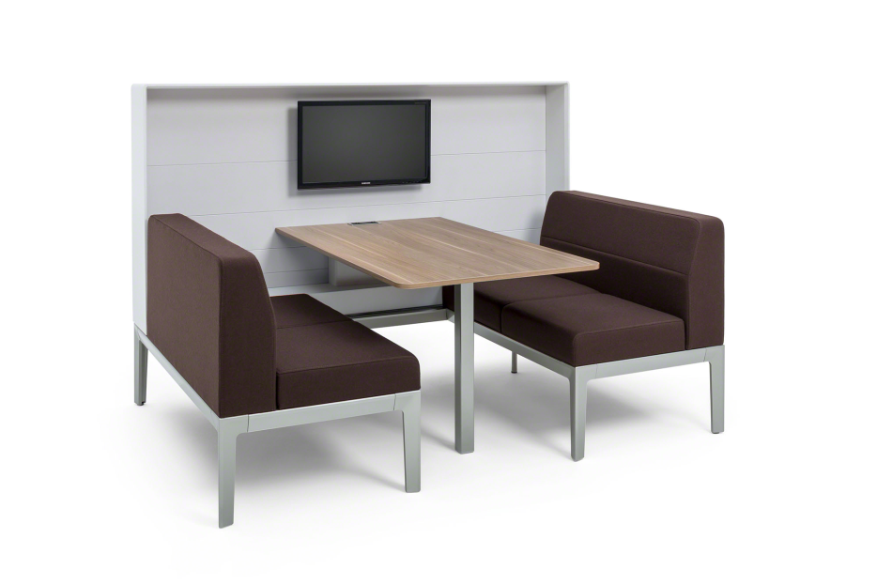
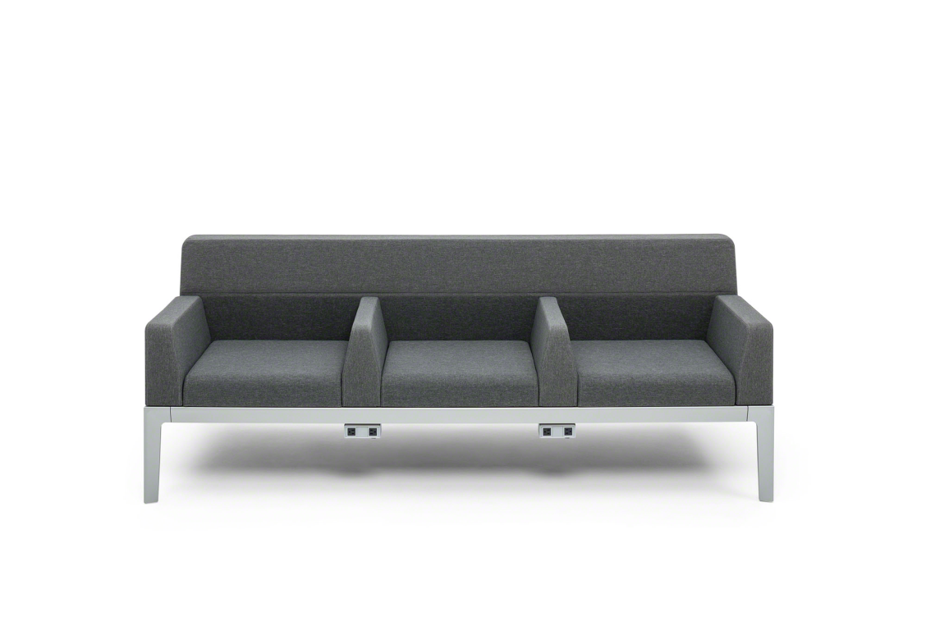
Regard
Features:
Boasts a frame-based, modular system of reconfigurable components
Affords meaning and productivity to transition spaces
Desk and media cabinets ensure productive waiting and optimize technology support
Privacy screens offer seclusion and emphasize appropriate division of space
Contour arm and in-line table offer optional power integration to support mobile devices
Frame understructure is welded tubular steel
Dynamic load 500 lbs.
Static load 750 lbs.
Available With:
Base frames in single-sided, double-sided, bench, and booth with table configurations
Single- and double-sided frames in widths from 44” to 88”
Seat cushions in 22”, 27 ½” and 33” widths; bench cushion
Single- and double-sided backs to match frame widths
5.5” and 11” single- and double-sided arms
Optional in-arm and under-frame power integration
Plastic arm caps
Coordinating freestanding tables and cabinets
Mobile Tablet
Storage end tables

Slide 11
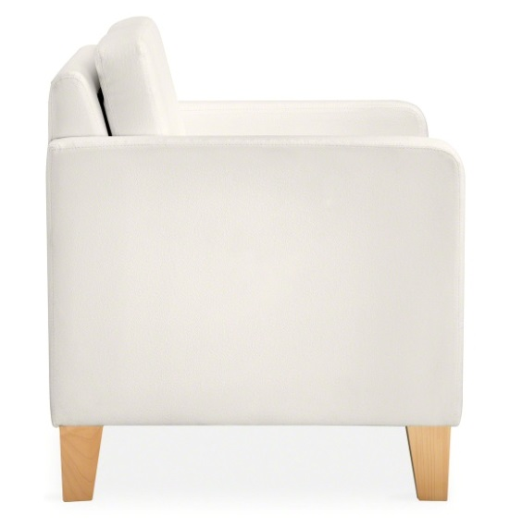
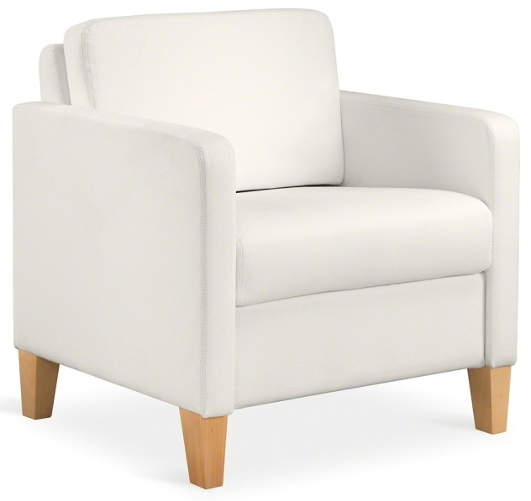
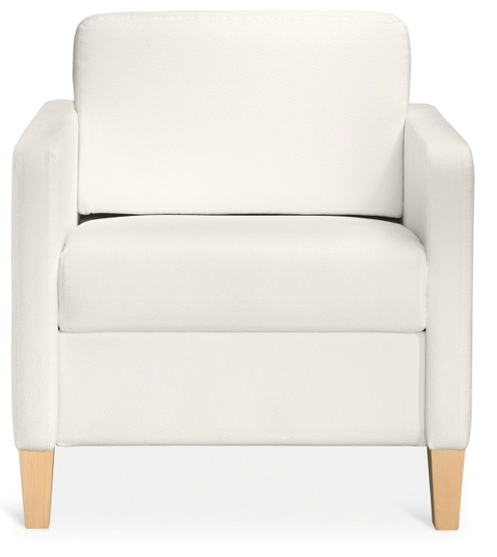
Sieste
Features:
Comfortable, clean design fits nicely in numerous environments
Durable hardwood frame with reinforced steel seat
Allows for field replacement through zippers and Velcro® closures
Incorporates space between seat and back for easy cleaning
Dynamic load 275 lbs.
Static load 500 lbs.
Available With:
Lounge, loveseat, sofa, and bariatric models
Upholstered, wood, or plastisol arm caps
Coordinating sleeper designs
Freestanding square tables in two heights
Moisture barrier

Slide 12
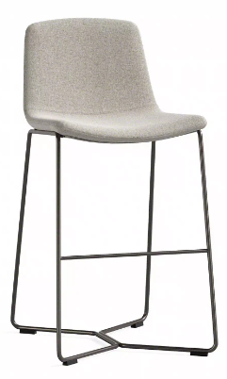
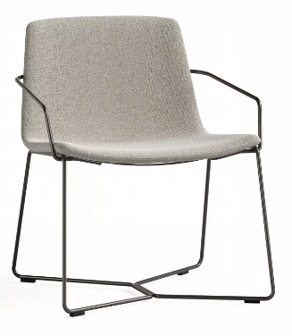
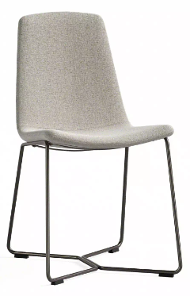
Slope
Features:
West Elm Slope’s iconic look with modified features to fit a healthcare environment
Modified for healthcare spaces with a decreased recline of 105 degrees
No vertical seams promote cleanability and infection control
Healthcare appropriate fabrics aid in durability and cleanability
Dynamic load 300 lbs.
Static load 500 lbs.
Available With:
Available as a single unit, bariatric unit, stacking chair, conference chair, bar height stool, and counter height stool
Products available with or without arms

Slide 13
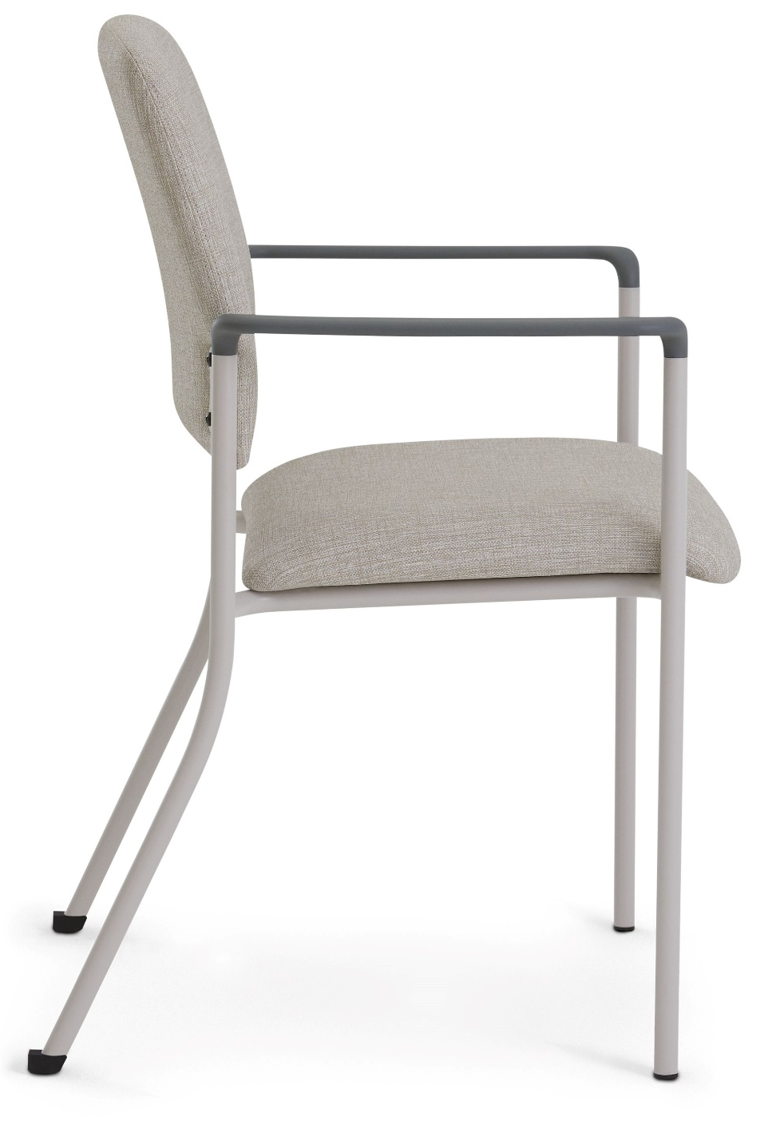
Sorrel
Features:
Light and stackable design to maximize space in healthcare environments
Powder coat painted steel frame
All Steelcase paints are available
2” thick foam seat
18” W or 22” W seat
Plastic arm caps
Dynamic load 300 lbs.
Static load 500 lbs.
Available With
Straight or wallsaver legs
Upholstered and maple wood back
Leg guards
Hard plastic or felt glides
Arms or armless units
Available as a single unit, bariatric unit, easy access unit,
Monolithic or contrasting healthcare appropriate fabrics
Moisture barrier option
Coordinating freestanding square tables
Ganging brackets

Slide 14
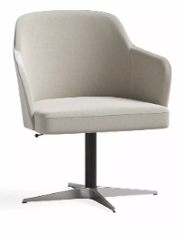
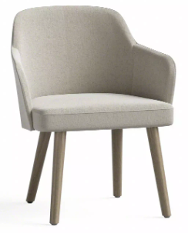
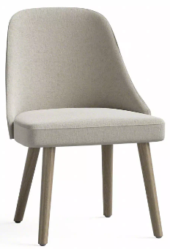
Sterling
Features:
West Elm Health’s Sterling is retro with a nod to mid century design
Modified for healthcare spaces with a decreased recline of 105 degrees and a crumbsweep
Healthcare appropriate fabrics aid in durability and cleanability
Meets BIFMA weight requirements
Dynamic load 300 lbs.
Static load 500 lbs.
Available With:
Available as a single unit, counter height stool, bar height stool, and conference chair
Wood or metal legs
Conference chairs are available with 4-star or 5-star metal bases

Slide 15
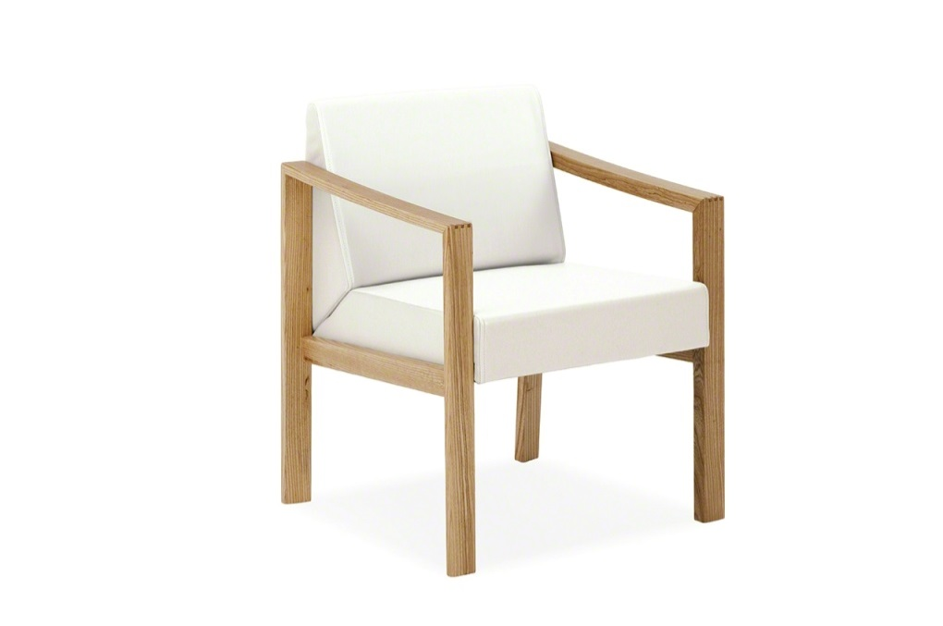
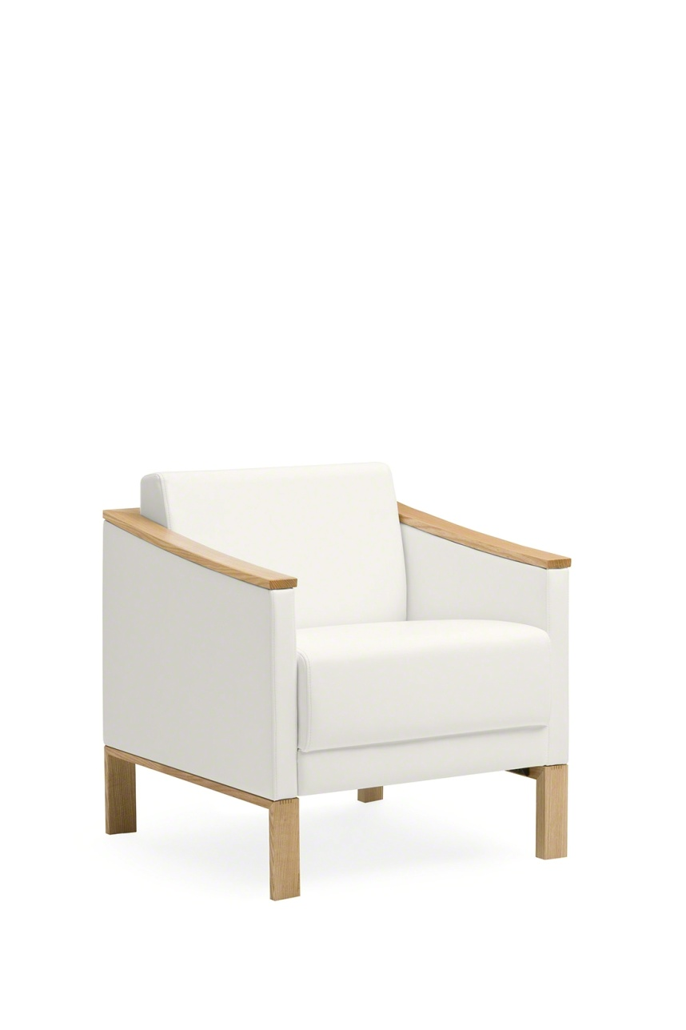
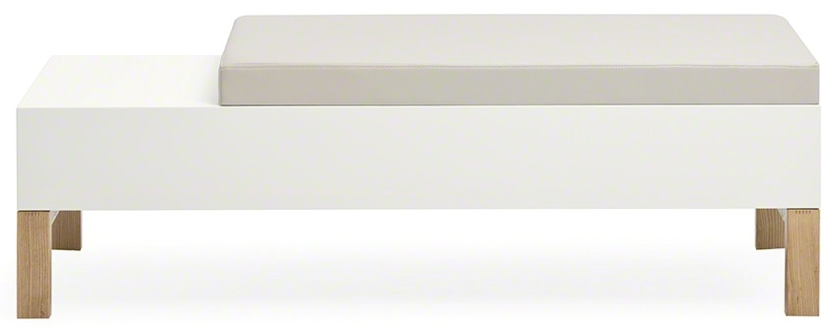
Tava
Features:
Supports high-traffic environments with structural integrity and durability
Boasts an elegant transitional design
Addresses aesthetic needs for small, intimate surroundings as well as open spaces
Arms and legs are ash wood with mitered finger joints for structural integrity
Withstands the rigors of heavy traffic through spring-seat construction and top-stitch care
Features a crumb sweep with easy floor access for effortless cleaning
Dynamic load 300 lbs.
Static load 750 lbs.
Available With:
Single-, two- and three-seat guest seating, lounges, loveseats, sofas, high back seating, bariatric seating, and benches
Closed and open arm designs for guest seating
Two-seat units with or without center arms
Table tops and bench bodies with solid surfaces or painted steel
Plastic arm caps
Square and rectangular side and coffee tables
Moisture barrier

Slide 16
Warranty
Steelcase Inc. warrants that Steelcase Health branded products are free from defects in materials and workmanship for the life of the product, except as set forth below. This warranty is valid from the date of shipment, regardless of shift usage, and covers the original purchaser for products delivered in the United States, Canada, Mexico, Latin America and the Caribbean.
Exceptions of the Lifetime Warranty:
12 years
Arm caps, foam, casters and glides, wood frame side chairs, tablet arms, laminate, wood veneer and solid surface
5 years
Recliner, sleeper mechanisms and associated levers and pedals, paint colorfastness, Steelcase Health wood finish
*Visit Steelcase.com for complete warranty details and information on specific fabric warranties

